Slide 1
Photomicrographs of Plant foods
Avocado
Permission to reproduce original photomicrographs used to make this collection may be obtained from
Dr. David O. Norris at
david.norris@colorado.edu

Slide 2
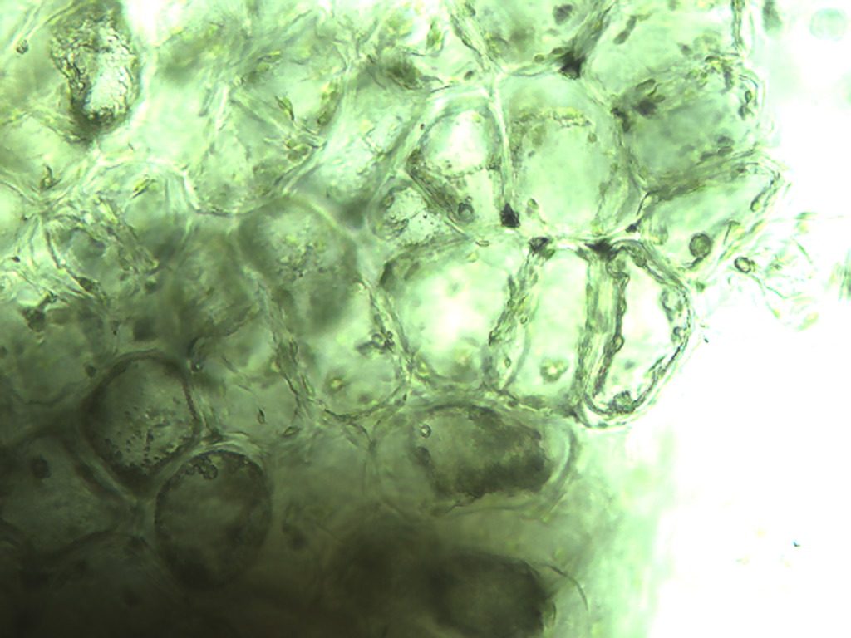
Notes:
26. Persea americana Mill. Avocado. Inner cells of skin, 25X

Slide 3
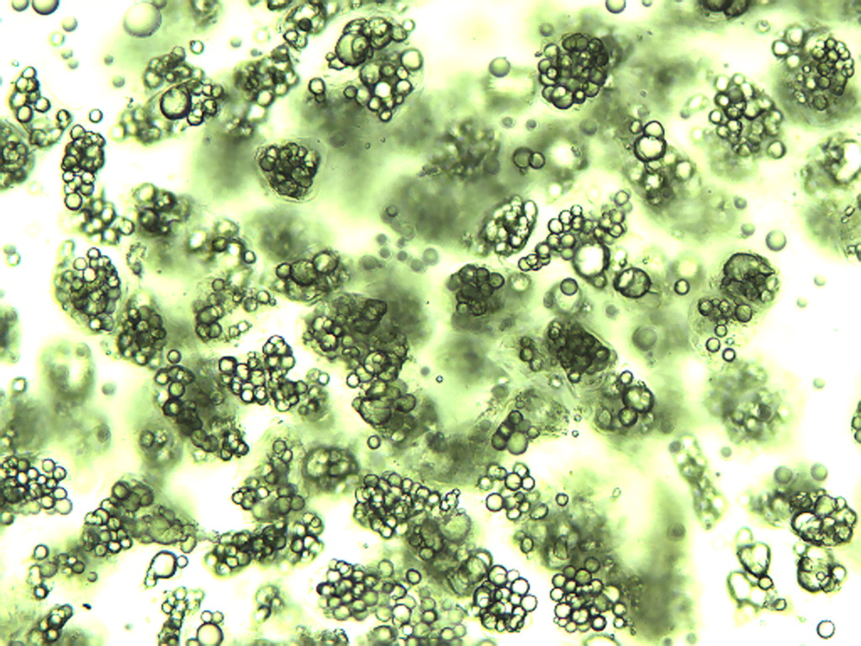
Notes:
27. Avocado. Oil droplets, typical of fresh avocado, 10X.

Slide 4
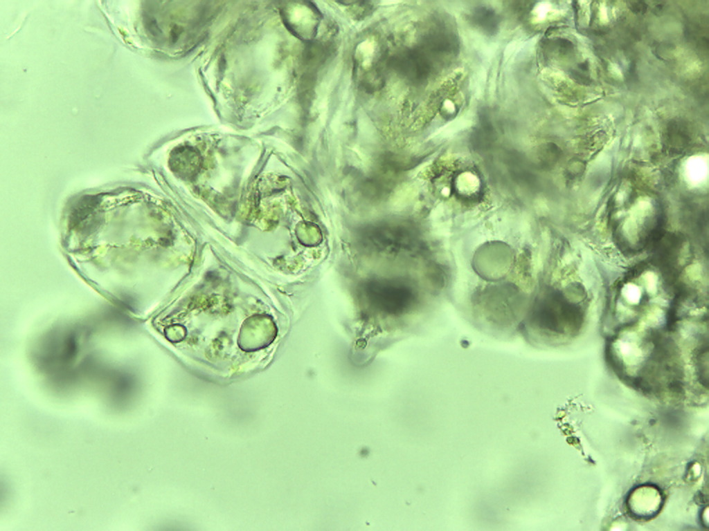
Notes:
28. Avocado. Parenchymal cells with a few oil droplets, 25X.

Slide 5
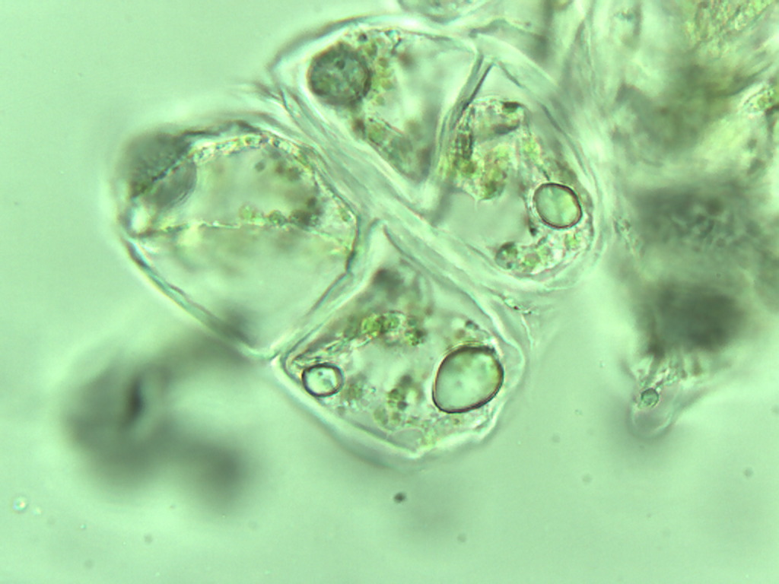
Notes:
29. Avocado. Parenchymal cells with few oil droplets, 40X.

Slide 6
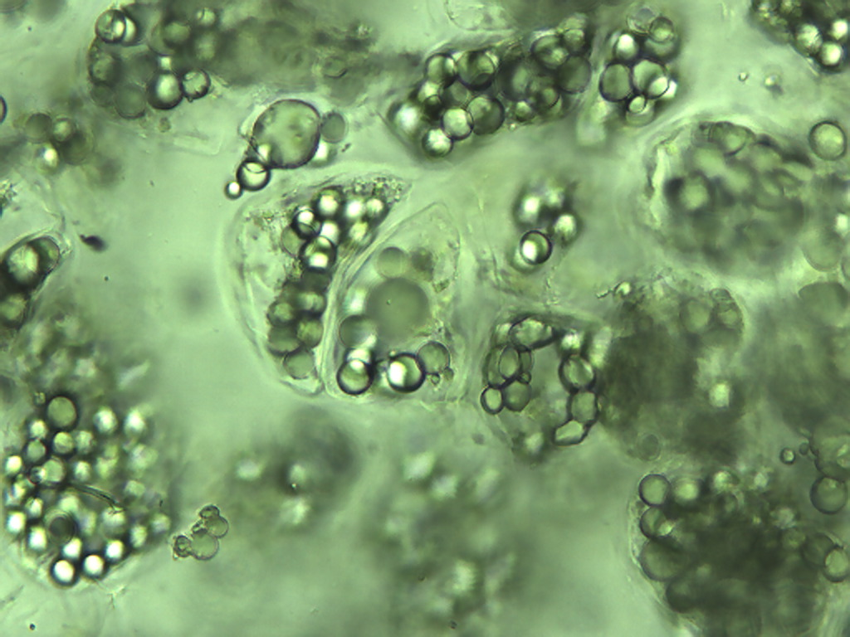
Notes:
30. Avocado. Parenchymal cells with numerous oil droplets, 25X.

Slide 7
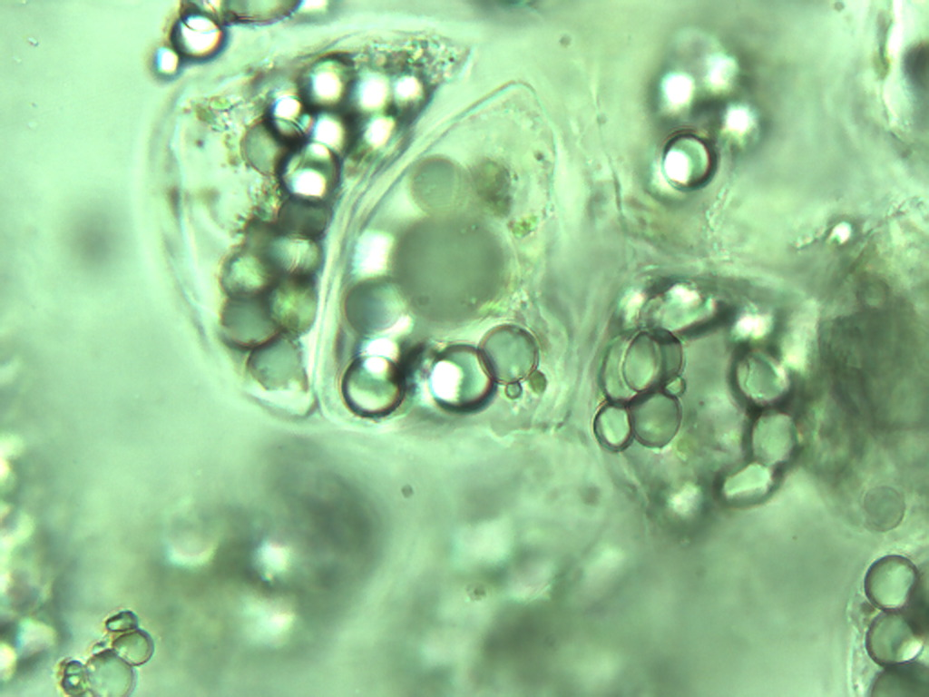
Notes:
31. Avocado. Parenchymal cells with numerous oil droplets, 40X.

Slide 8
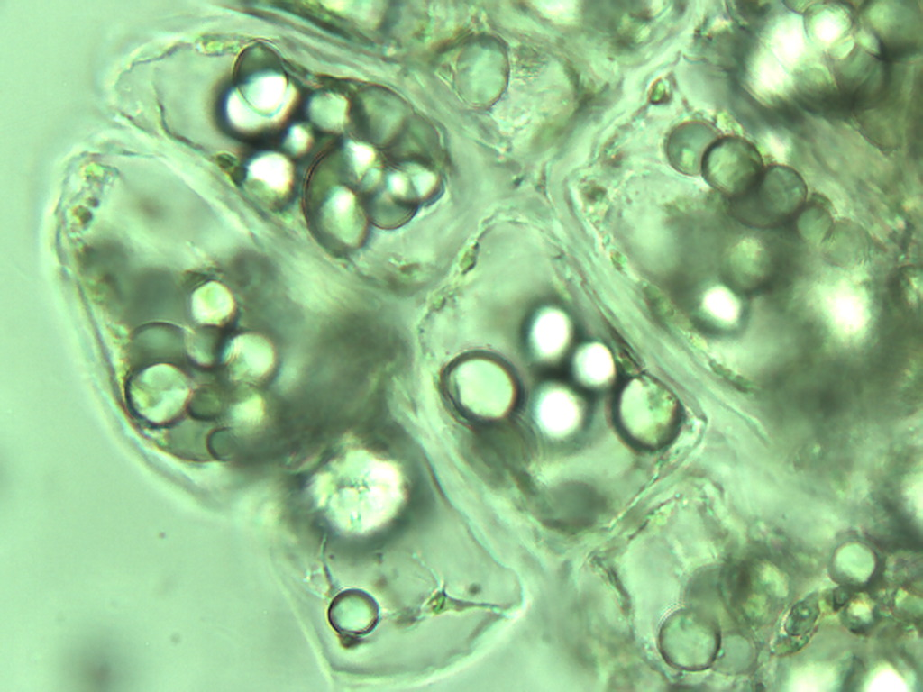
Notes:
32. Avocado. Parenchymal cells with numerous oil droplets, 40X.

